Slide 1
Data Exploration

Slide 2
Data
Something given-an observation or a fact about a subject
Data Science identifies useful relationships within data
Data exploration helps to understand data better, prepares data that makes advanced analysis possible
Data exploration understands the structure of the data, distribution of the values and the interrelationships between the attributes of the data set
Two types
Descriptive statistics –condensing key characteristics of the dataset into simple numeric metrics-mean, standard deviation, correlation
Visualization-projecting the data into multidimensional space or abstract images

Slide 3
Types of Data
What kind of operations can be performed on that attribute
Numeric (31.5oC), ordered labels (hot,mild,cold)
Number of days with in a year below zero degree
Numeric or Continuous- Additive, subtractive,logical and ratio operations can be performed
Categorical-Color of the eye-black, blue, gray-no direct relationship between data values
Mathematical operators except logical cannot be applied
Ordered nominal-some kind of ordering between the values-hot, mild, cold
Type conversion process converts one data type to another-numeric score to categories

Slide 4
Descriptive statistics
Study of the aggregate quantities of the data set
Average annual income, median home price in a neighbourhood
Centre of the dataset-mean,median,mode
Spread-range, variance, standard deviation
Shape of the distribution of the data set-Symmetry, skewness
Two types-Univariate and multivariate exploration depending on the number of attributes under analysis

Slide 5
Univariate exploration
Analysis of one attribute at a time
Measures of central tendency
Mean-Arithmetic average of all observations in the data set, affected if outliers are present
Median-value of the central point in the distribution
Mid point observation in the sorted list
Mode-most frequently occurring observation
Mean and median are fairly similar, sometimes mean vary much if outlier are present
Measure of spread
Range-difference between maximum and minimum value-affected by outliers, fails to consider the distribution of other points in the attributes
Deviation-Difference between a given value and the mean-variance and standard deviation

Slide 6
In probability theory and statistics, variance is the expectation of the squared deviation of a random variable from its population mean or sample mean. Variance is a measure of dispersion, meaning it is a measure of how far a set of numbers is spread out from their average value.
Σ(Xi−¯X)2/N
Sum of the squared deviation of all data points/number of data points
Standard deviation is the square root of variance
High standard deviation means the data points are spread widely around the central point
Low means data points are closer to the central point
If the distribution of the data aligns with the normal distribution, 68% of the data points align within one standard deviation from mean

Slide 7
Multivariate Exploration
Study of more than one attribute in the data set simultaneously
Understanding the relationship between the attributes
Central mean point
Correlation-relationship between the attributes-dependence of one attribute on another attribute
Correlation takes a value from -1 to +1
Appetitive and temp
Quantity of product sold and revenue-perfect correlation
0 means no linear relationship between the attributes

Slide 8
Data Visualization
Comprehension of dense information
Can include thousands of data points
trends can be identified easily than calculating statistical metrics
Relationships-easy exploration of relationships between the attributes
Selecting suitable visuals to explore data is important in discovering and comprehending hidden patterns in the data
Univariate and multivariate visualization

Slide 9
Univariate visualization
Histogram
A histogram is a graphical representation of data points organized into user-specified ranges. Similar in appearance to a bar graph, the histogram condenses a data series into an easily interpreted visual by taking many data points and grouping them into logical ranges or bins.
To understand the frequency of occurrence of values
Shows the distribution of data by plotting the frequency of occurrence in a range
Attribute of inquiry in the horizontal axis and the frequency of occurrence in the vertical axis
Number of bins is equal to the square root or cube root of the number of data points
A histogram can be stratified to include different classes to gain more insight
Histograms are used to find the central location, range and shape of the distribution

Slide 10
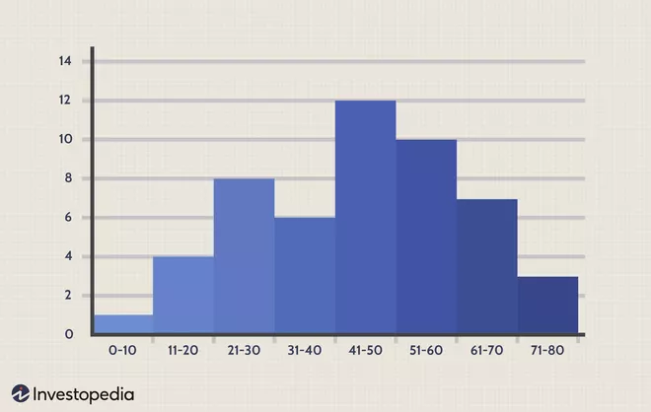
a histogram to show how many people are between the ages of zero - 10, 11 - 20, 21 - 30, 31 - 40, 41 - 50, 51 -60, 61 - 70, and 71 - 80.

Slide 12
Boxplot
A Box plot is a way to visualize the distribution of the data by using a box and some vertical lines. It is known as the whisker plot. The data can be distributed between five key ranges, which are as follows:
Minimum: Q1-1.5*IQR
1st quartile (Q1): 25th percentile
Median:50th percentile
3rd quartile(Q3):75th percentile
Maximum: Q3+1.5*IQR
Here IQR represents the InterQuartile Range which starts from the first quartile (Q1) and ends at the third quartile (Q3).

Slide 13
Visualizing numeric variables – boxplots
A box whisker plot is a simple visual way of showing the distribution of a continuous variable with quartliles, median and outliers
In a distribution 25% of data points will be below Q1, 50% will be below Q2, and 75% will be below Q3

Slide 14
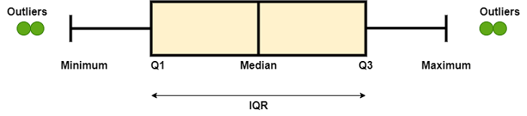
Visualizing numeric variables – boxplots
In the box plot, those points which are out of range are called outliers
The number of outliers in a dataset
Is the data skewed or not
The range of the data
The range of the data from minimum to maximum is called the whisker limit. In Python, we will use the matplotlib module's pyplot module, which has an inbuilt function named boxplot() which can create the box plot of any data set.

Slide 15
Visualizing numeric variables – boxplots
The box-and-whiskers plot depicts the five-number summary values using the horizontal lines and dots.
The horizontal lines forming the box in the middle of each figure represent Q1, Q2 (the median), and Q3 while reading the plot from the bottom to the top.
The minimum and maximum values are shown using whiskers that extend above and below the box. Usually whiskers are allowed to extend to a minimum or maximum of 1.5 times the IQR below Q1 or above Q3

Slide 16
Distribution Chart
A variable's distribution describes how likely a value is to fall within various ranges.
If all the values are equally likely to occur—then the distribution is said to be uniform.
A uniform distribution is easy to detect with a histogram, because the bars are approximately the same height.

Slide 17
In fact, on the price histogram, it seems that values grow less likely to occur as they are further away from both sides of the center bar, resulting in a bell-shaped distribution of data.

Slide 18
The normal distribution, can be defined with : center and spread.
The center of normal distribution is defined by its mean value
The spread is measured by a statistic called the standard deviation

Slide 19
The standard deviation indicates, on average, how much each value differs from the mean.
The standard deviation can be used to quickly estimate how extreme a given value is under the assumption that it came from a normal distribution.
The 68-95-99.7 rule states that 68 percent of the values in a normal distribution fall within one standard deviation of the mean, while 95 percent and 99.7 percent of the values fall within two and three standard deviations, respectively.

Slide 21
Multivariate visualization
More than one attribute in the same plot
Scatter plot
Bivariate relationship
It is a two dimensional figure in which dots are drawn on a coordinate plane using values of one feature in the x-coordinate another feature values in the y coordinate
Linear correlation-data points align closer to an imaginary straight line
Otherwise scattered
Identifies patterns, group of clusters, outliers

Slide 22
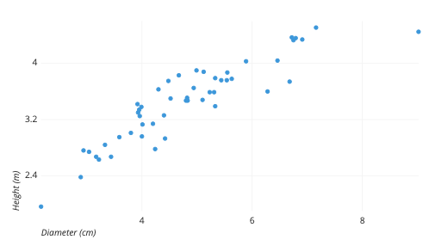
Each dot represents a single tree; each point’s horizontal position indicates that tree’s diameter (in centimeters) and the vertical position indicates that tree’s height (in meters). From the plot, we can see a generally tight positive correlation between a tree’s diameter and its height. We can also observe an outlier point, a tree that has a much larger diameter than the others. This tree appears fairly short for its girth, which might warrant further investigation.

Slide 23
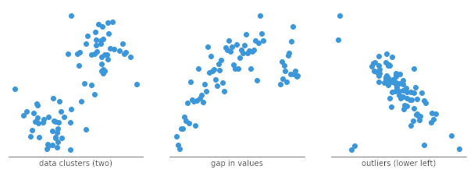
Identification of correlational relationships are common with scatter plots.
Identification of clusters
Gaps
Outliers

Slide 24
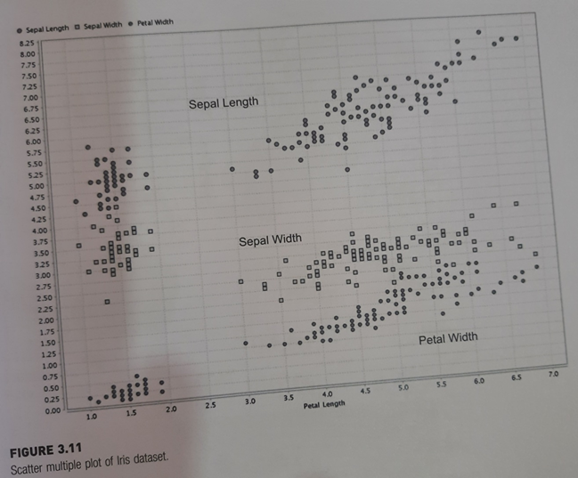
Scatter Mutiple
More than two dimensions
Primary attribute is the x-axis coordinate
Secondary axis has more dimensions/attributes
Y-axis-sepal length, sepal
Width petal width
X-axis-Petal length different
colors

Slide 25
Scatter Matrix
If the dataset has more than two attributes, scatter matrix compares all combination of attributes with individual scatter plots
16 scatter plots in Iris dataset
6 distinct comparisons for 4 attributes
Provides an effective visualization of comparative, multivariate, high density data in small multiples of similar scatter plots

Slide 26
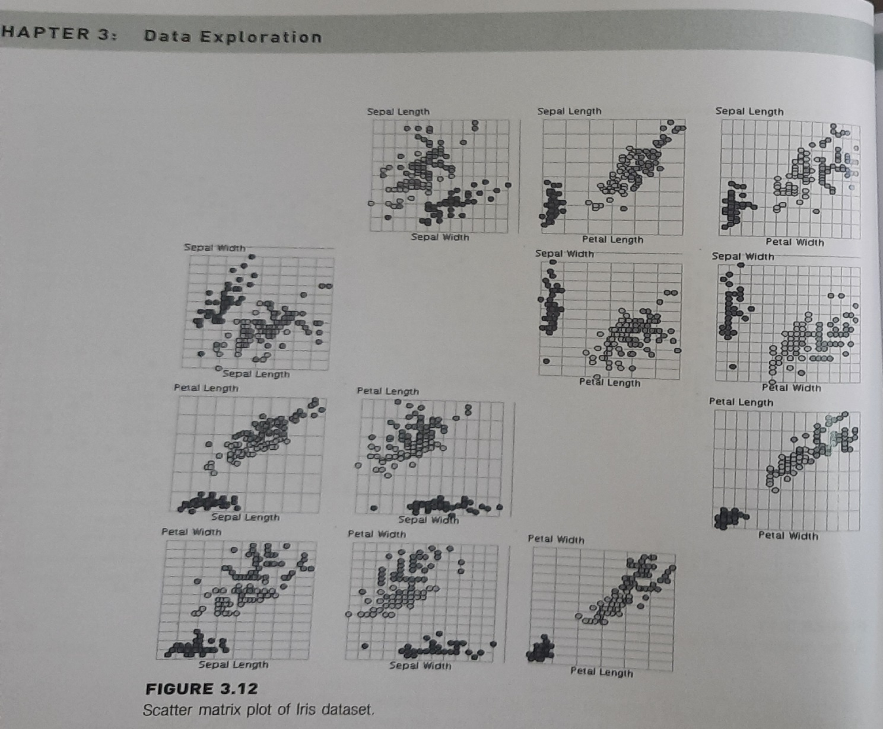
Scatter matrix

Slide 27
Bubble chart, Density Chart
Bubble chart-Similar to scatter plot with the addition of one more attribute to determine the size of the data point
Density chart-Similar to scatter plots, with one more dimensions as a background color
Petal length x-axis, sepal length y-axis, sepal width background color, class label for the data point color

Slide 28
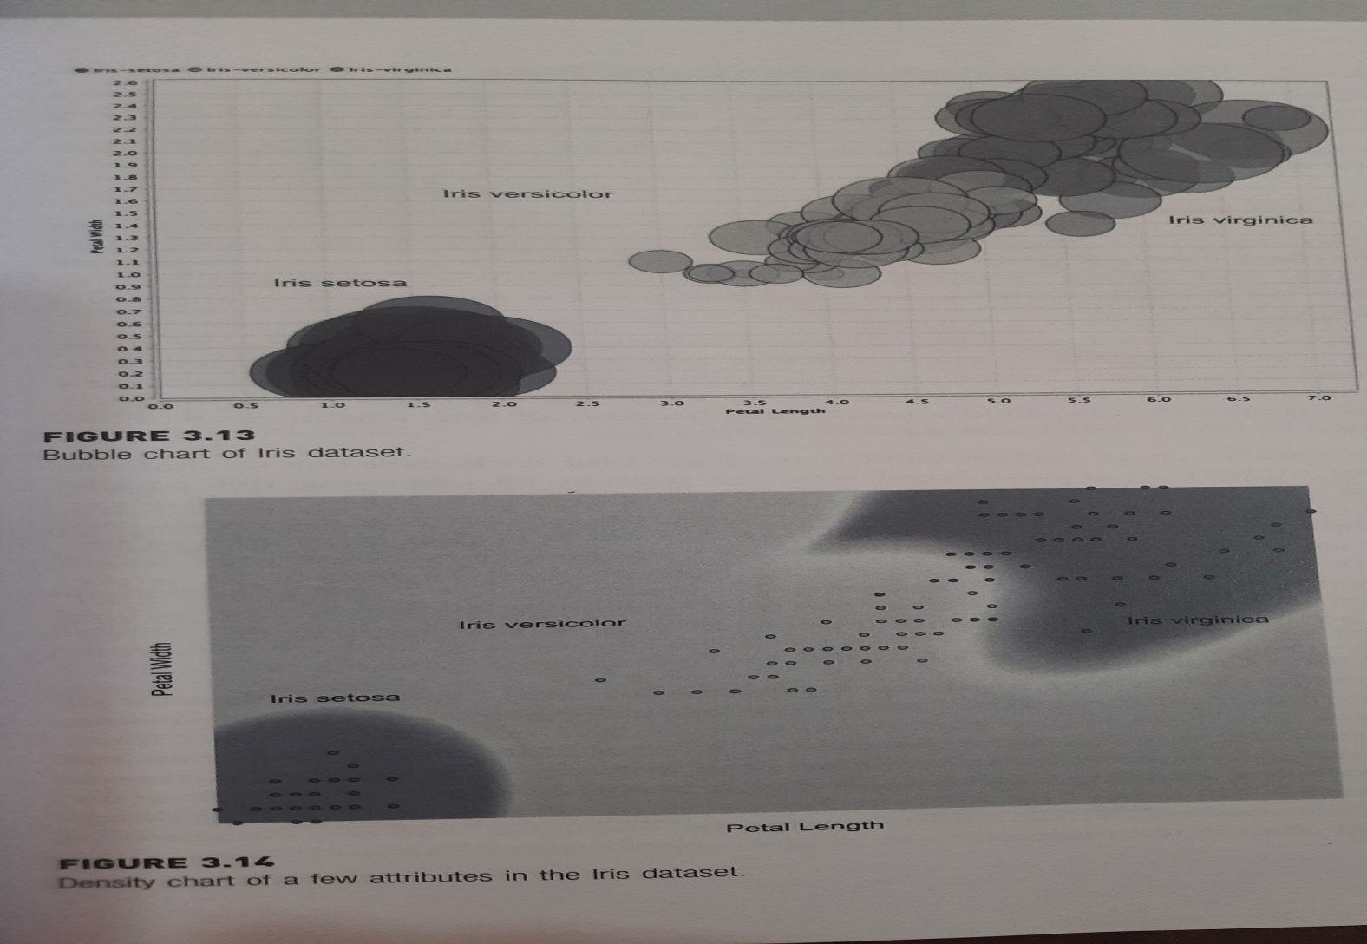

Slide 29


